Slide 1
People and Automation: Successfully Scaling a Security Program
Anthony Langsworth
Senior Security Architect
Dimension Data
July 2017
Notes:
Audience: People embedded inside an organization starting a security program or want to scale up and existing program.
Level: Mid level technical. The goal is to get security people thinking at a higher level, one appropriate for communicating with management.
My focus is on software development and AppSec but much of this is generally applicable.

Slide 2



Who am I?
AppSec for software development teams in Sydney, USA and Canada. Built the program from scratch.
Drive Networking and Security R&D portfolios.
Previously Technical Director at
2 US security patents and 1 Australian security patent application
23K+ reputation on various sites
In top 50 contributors to .Net Core
Obligatory CISSP, CCSP and CCSK
Occasional crimes against blogging at randomactsofarchitecture.com

Slide 3
What is success?
“
If you don't know where you want to go, then it doesn't matter which path you take.
”
- The Cheshire Cat (Alice in Wonderland)
Notes:
Security is traditionally a game you cannot win. Redefining success is important both for business alignment and job satisfaction.

Slide 4
Drivers
Fix problems then drive via customers or compliance.
Panic driven
Security is keeping things going
Fire Fighting
Competitive Advantage or Market Demand
Customer driven
Security is a feature
Security
Program
Discover position then drive via customers or compliance.
GRC, legal or policy driven
Security is a minimum bar
Compliance
(e.g. ISO 27001, PCI DSS, IRAP)
Ignorance
IC frustration or management curiosity driven
Security is an unknown. Consider ASD.
Driver(s) determine:
Stakeholders
Success criteria
Notes:
What is a security program?
Drivers are not mutually exclusive

Slide 5
People
Goal: Deliver product/service
Goal: Meet deadline
Goal: Minimize cost
Challenge: Avoid unnecessary work
Challenge: Hide “dirty laundry”
Management
Goal: Pass audit
Challenge: Prioritizes on contract or policy, not impact
Security
Program
Goal: Successful product/service
Challenge: Prioritizes on demand, not impact
Challenge: Not security experts
Compliance
Customer
Goal: Work my way
Goal: Make security obvious and easy
Challenge: Varying security knowledge
Implementers
Operators
Assurance

Slide 6
Scaling
“
It takes all the running you can do to keep in the same place.
”
- Red Queen (Through the Looking Glass)
Notes:
The person most impacted by not improving is you.
Like saying “I am too thirsty to drink”

Slide 7

Time Allocation
What do you spend your time on?
What should you spend your time on?
Image Source: https://www.pexels.com/photo/ numbers-time-watch-white-1778/
Notes:
Scaling = spending time on 10x instead of 1x activities
Scaling != automating everything
Too starving to eat

Slide 8
Automation Principles
Trust and verify
Breadth before depth
Save instead of create work
Common tools and processes
Highest cost savings, easiest onboarding
Standardized
Abstracted
Different tools and processes but differences hidden
May be dictated by environments, teams or processes
Ad hoc
Still beneficial
Prototyped
Defined
Defined tools and processes
Stakeholder agreement

Slide 9
Tool Automation Considerations
Examples:
Add or extend capabilities
Create custom reports
Collate data from existing tools
ETL data to/from other tools
Add to automated workflow
Determines mechanism (e.g. customize vs scripting vs workflow vs application)
Features
Built-in (Engine, Rules/Templates)
Extensibility (APIs, customization)
Integrations/Modules
Roadmap (with care)
Gaps
Capabilities
Reporting/Dashboards
Covered by APIs or customization?
Environment
User’s technical capabilities
Processes
Licensing

Slide 10
Automation Risks and Mitigations
General:
Software developers can help with any code
Remember security (e.g. authentication, logging, minimum access)
Vendor
lock-in
Use libraries
Build abstractions in (proxy vs façade vs adapter patterns)
Automation
Bugs
Separate test environment
Version code e.g. git
Mock products
Automated tests
Code reviews

Slide 11
Integrating Detection Tools into Process
Project (release) tasks
Why move to regular?
Faster feedback for implementers
Faster feedback to you
Removes security as a project hurdle
Fits with agile/scrum
Regular (sprint) tasks
No user input when running
Hours (or faster) to run
Appropriate license model
Deltas (or APIs to create them)
E.g. vulnerability scans, static analysis scans

Slide 12
Detection Tool Workflow
Collate scan results
Remove false positives
Raise in issue tracking tool
Secondary notification
Install and configure tools
Onboarding
Service/Product standards
Publish known issues, workarounds
Evangelize
Agree on priorities
Issue templates
Create reference explanations
Email template
Project notification list
Create reports and dashboards
Preparation
Review delta
Adjust rules/scans, configuration, standards
Verify rules
Raise issues
Adjust priorities, templates, explanations
Send notification
Manual
Configure rules/scans
Custom rules/scans
Collate results of multiple projects/tools
Generate reports and dashboards
Automation
Notes:
Issue templates: Clone an existing incident?

Slide 13
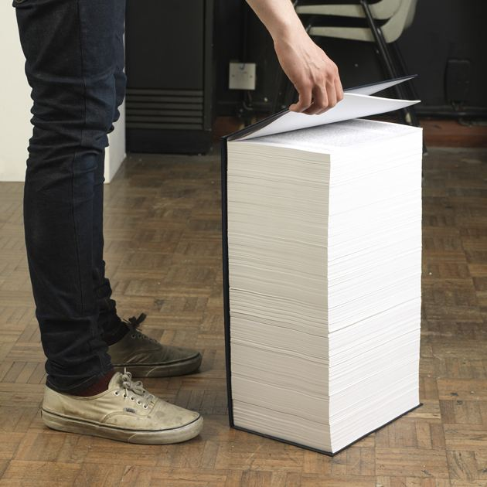
Raising Issues
Look familiar?
How much actually gets read?
How much work does this create?
Source: https://www.geek.com/geek-cetera /0-01-of-wikipedia-turned-into-5000-page-book-1336419/
Notes:
See Lean definition of “Waste” and “Value Streaming”
Intro, background, etc to Wiki or website
Needs to be prioritized and re-entered

Slide 14
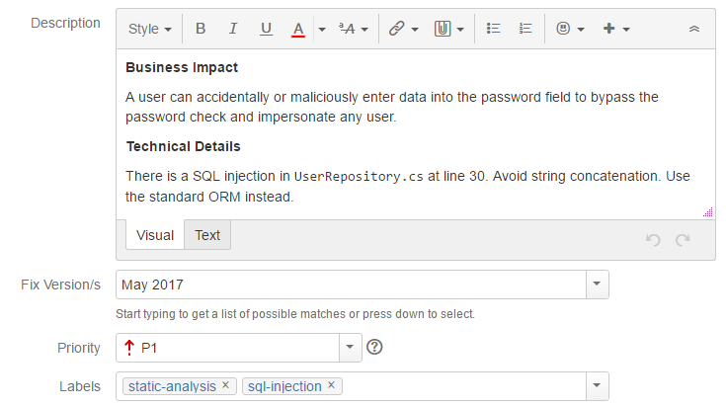
Raise Issues in Existing Issue Tracking Tool
Create security project/epic
Start with reusable template.
Handle different audiences (technical and nontechnical).
Move explanations elsewhere.
One per issue type.
Add value!
Follow team’s guidelines.
Categorize with labels or tags. Use existing tools reports and dashboards.
Use predefined priorities (and judgement)

Slide 15
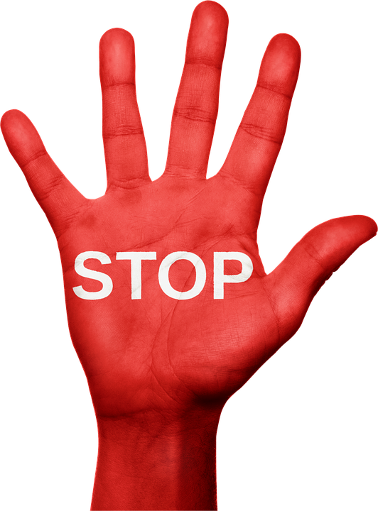
Issue Pushback
Do not avoid it!
Support with published, agreed priorities, stakeholders
Split systemic issues into immediate problems and longer term fixes
Give a little. Trust and verify.
Feed results back into
New issue types
Changing priorities
Education
Source: https://pixabay.com/en/no-stop-negative-emotion-anger-987086/

Slide 16

Automated Remediation
Risks
Self DOS
False sense of security
Change approval challenges
Better
Increase scrutiny, e.g. new rules or tools, increase frequency
Alert operator

Slide 17
Leverage Automation Elsewhere …
Workload Deployment
e.g. HashiCorp Terraform
Review scripts and configuration instead of or in addition to machines
Add your own scripts or configuration to the pipeline
Tool activity log
Identify new systems that need securing
See what changes have been made
IaaS
e.g. AWS or Azure
AWS: Cloud Trail, Inspector
Containers
e.g. Docker, Kubernetes
Configuration Management
OS Configuration
e.g. Chef, Puppet, Ansible
Application Deployment
e.g. Octopus Deploy
Notes:
Review tool history to see what changes have been made and identify new systems that need securing.

Slide 18
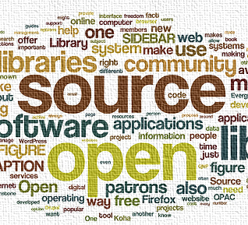
… or Build Solutions
Write or borrow code, queries/rules or scripts
Community benefit versus competitive advantage
Source: http://openinnovation.net/category/ developing-open-services-innovation/
Notes:
E.g. cannot share Checkmarx rules
Attack has lots of open source tools. Defence is rarely shared.

Slide 19
Summary
What is driving your security program?
Who are affected? What do they need? How do they work?
What is taking up your time?
What automation opportunities exist?
How can I create a feedback loop?
What can I build?

Slide 20
Looking Back
“
It’s no use going back to yesterday, because I was a different person then.
”
- Alice (Alice in Wonderland)
Notes:
The person most impacted by not improving is you.
Like saying “I am too thirsty to drink”

Slide 21
Thanks!
Twitter: @alangsworth
https://randomactsofarchitecture.com

